Slide 1







Data Science Project
Titanic Survival Prediction Using Machine Learning Models

Slide 2







Dataset Overview
The Titanic dataset on Kaggle is one of the most popular datasets for beginners in data science and machine learning. It focuses on the survival outcomes of passengers aboard the RMS Titanic, which famously sank after colliding with an iceberg on April 15, 1912.
The Titanic dataset includes information about each passenger, such as:
PassengerId: Unique identifier for each passenger
Survived: Survival status (0 = No, 1 = Yes)
Pclass: Passenger class (1 = First, 2 = Second, 3 = Third)
Name: Name of the passenger
Sex: Gender of the passenger
Age: Age of the passenger
SibSp: Number of siblings/spouses aboard the Titanic
Parch: Number of parents/children aboard the Titanic
Ticket: Ticket number
Fare: Fare paid by the passenger
Cabin: Cabin number
Embarked: Port of embarkation (C = Cherbourg, Q = Queenstown, S = Southampton)

Slide 3
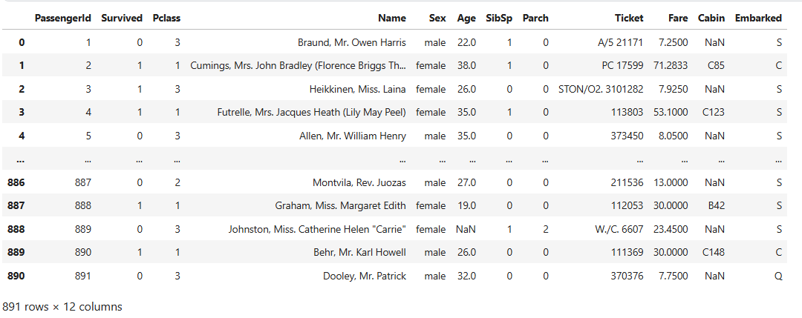
Dataset Overview

Slide 4








Problem statement
How can we analyze the features that influence passenger survival on the Titanic?
Which machine learning models, including Random Forest, Decision Trees, and Logistic Regression, are most effective in predicting the survival outcomes of Titanic passengers?
Discussion Steps
Pre-Processing Data
Data Exploration
Feature Engineering
Modelling & Evaluation

Slide 5


1.
Preprocessing Data

Slide 6
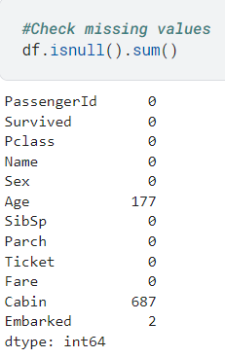
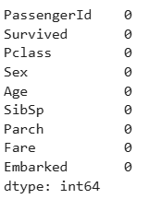
Check Missing Values
Before
After
Steps
Fill in the missing values in 'Age' Column with Median.
Fill in the missing values in 'Embarked' Column with Mode
Remove "Cabin" column because too many missing values.
Remove "Name" and "Ticket" columns because it will not be used for analysis.
.

Slide 7







2.
Data Exploration

Slide 8


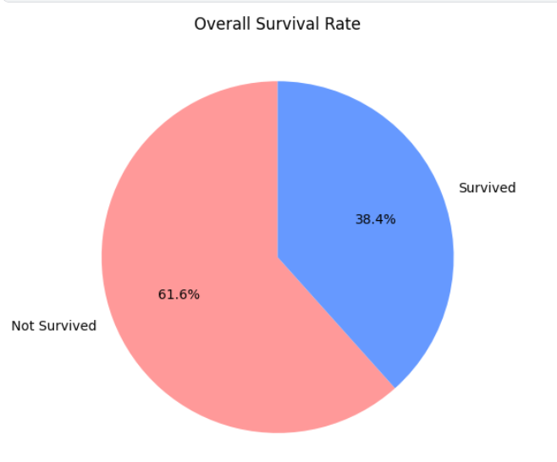
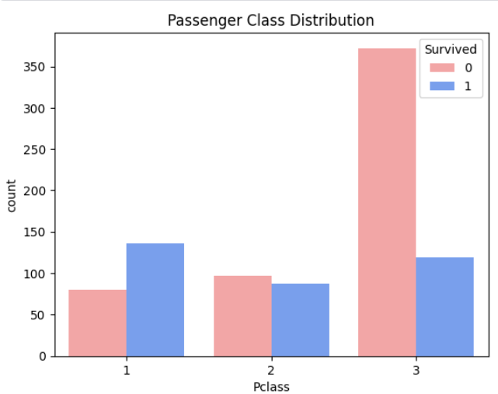
Survival Rate
Survival Rate by PClass
The data highlights that the majority of individuals did not survive, while a smaller portion did.
Passengers in higher classes (1st class) had a better chance of survival than those in lower classes (3rd class).

Slide 9


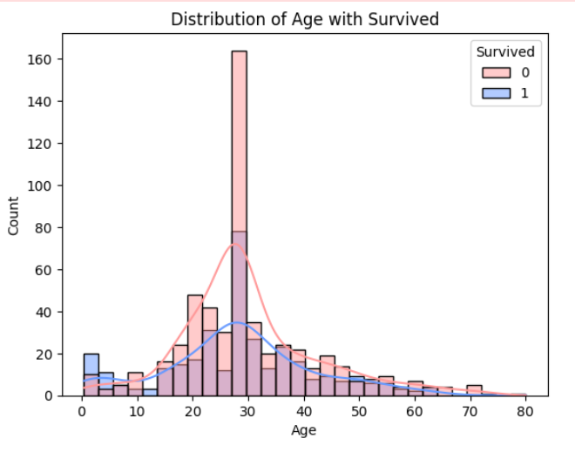
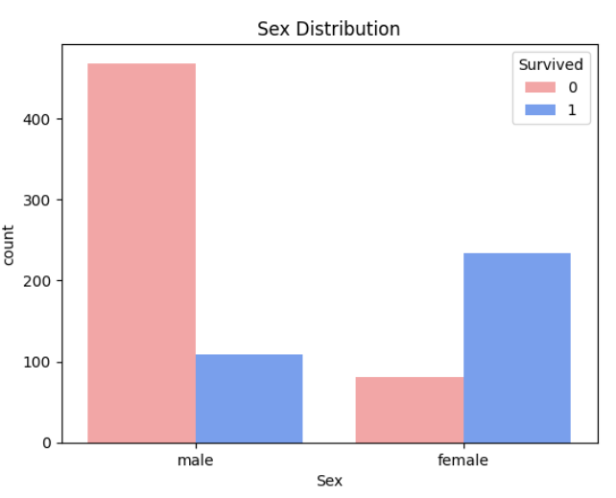

Survival Rate by Age
Survival Rate by Sex
This visualization illustrates that age was a factor in survival outcomes, with younger children having a higher chance of survival and young adults facing a higher risk of not surviving.
The chart suggests that female had a higher survival rate than male.

Slide 10

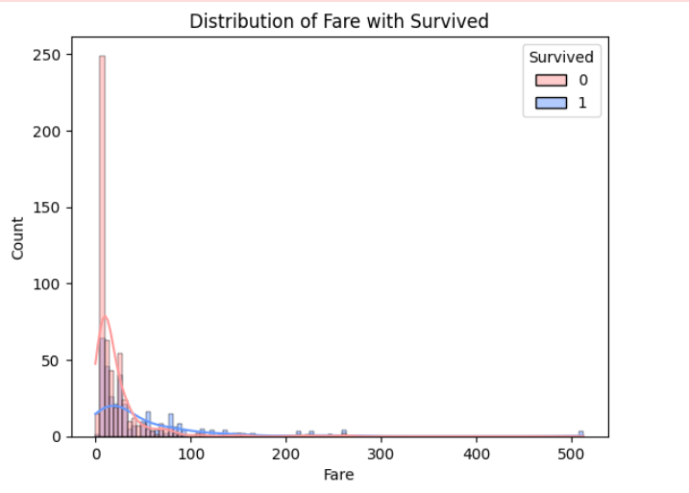
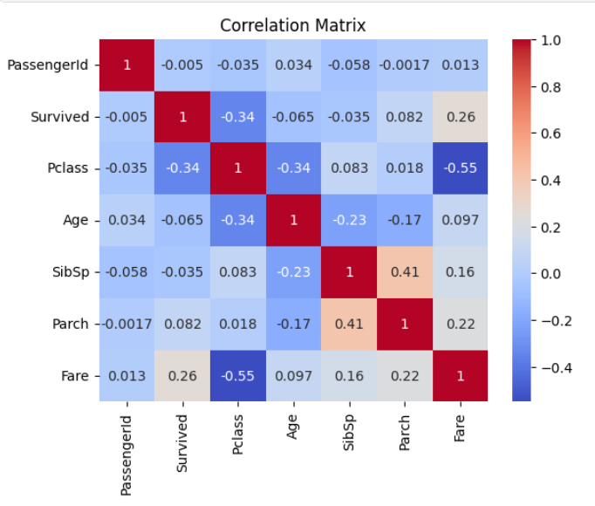
Survival Rate by Fare
Correlation Matrix
A higher fare might be associated with a better survival rate, although the majority of passengers paid low fares, and survival among this group was generally lower.
Pclass and Fare have a negative correlation: the lower the Pclass (indicating higher social class), the higher the Fare.
The feature with the greatest impact on Survived is Pclass.

Slide 11


3.
Feature Engineering

Slide 12
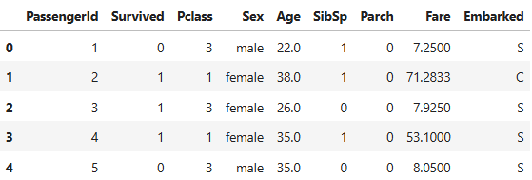
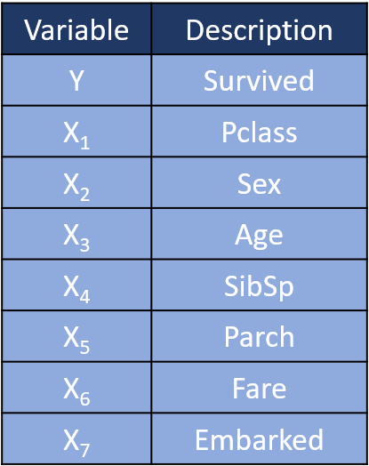

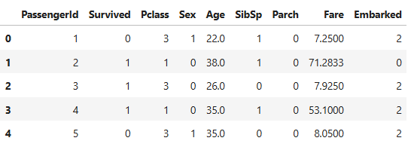
a. Label Encoder: convert categorical data into numeric
b. Feature Selection : identifying and selecting the most relevant features (variables, predictors) from a dataset for use in building a machine learning model

Slide 13

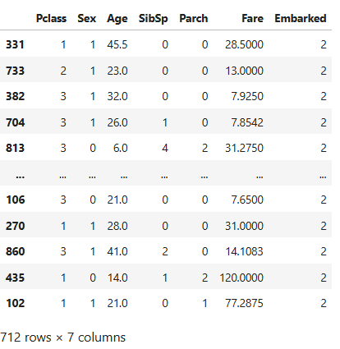
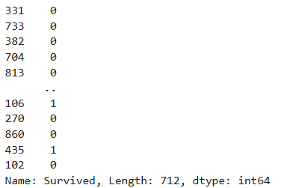
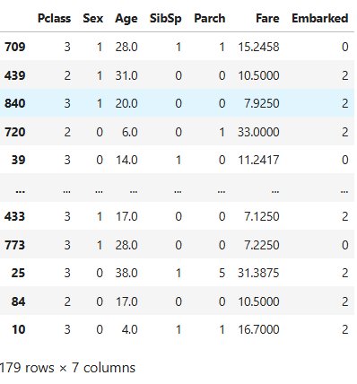
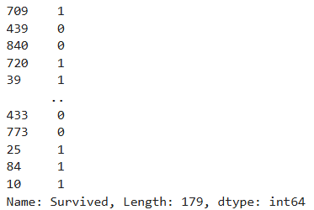



c. Data Split
Dividing a dataset into separate subsets to train and test a machine learning model.
Data Train X
Data Train Y
Data Test X
Data Test Y
80% of the data used for training the model.
Remaining 20% used for evaluating the model's performance

Slide 14



4.
Modeling and Evaluation

Slide 15
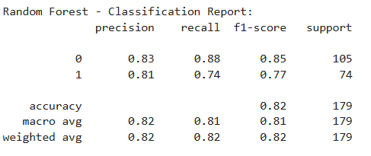
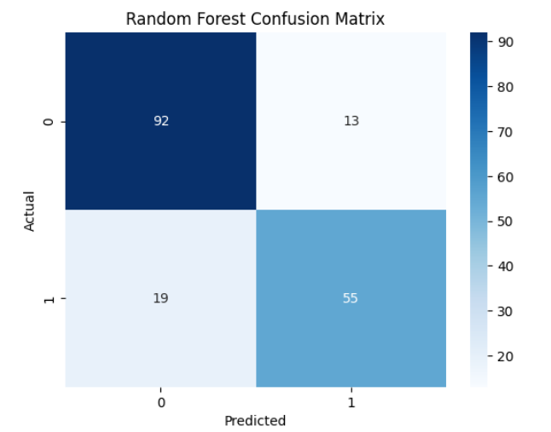
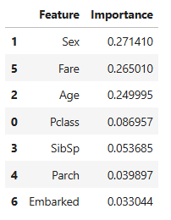
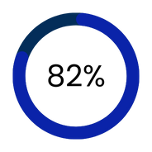
Clasification Report
Cofusion Matrix
A.
Feature Improtance
Random Forest
Random Forest Accuracy

Slide 16
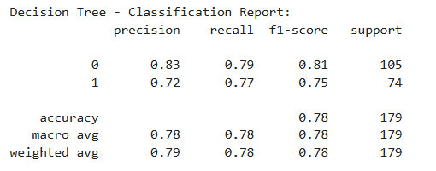
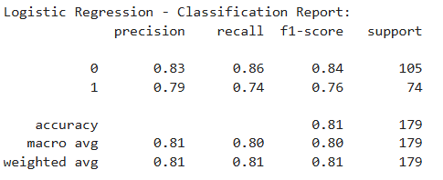
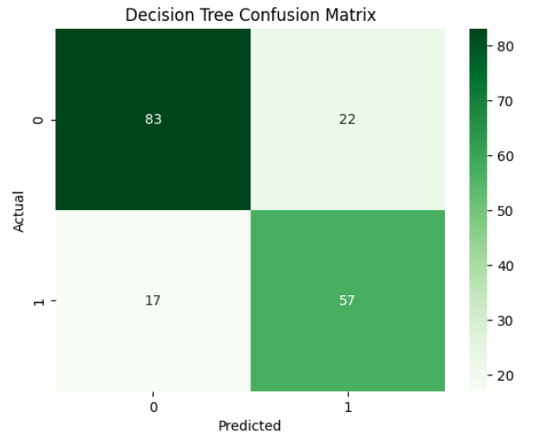
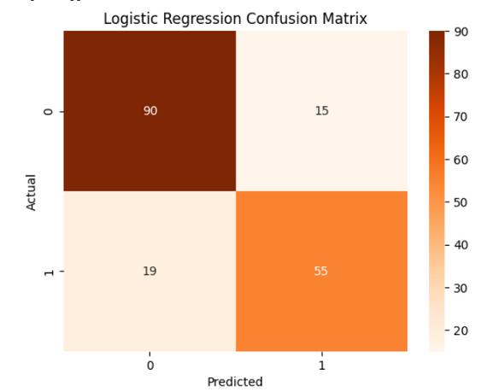


B. Decision Tree
C. Logistic Regression
Clasification Report
Confusion Matrix
Decision Tree Accuracy
Logistic Regression Accuracy

Slide 17

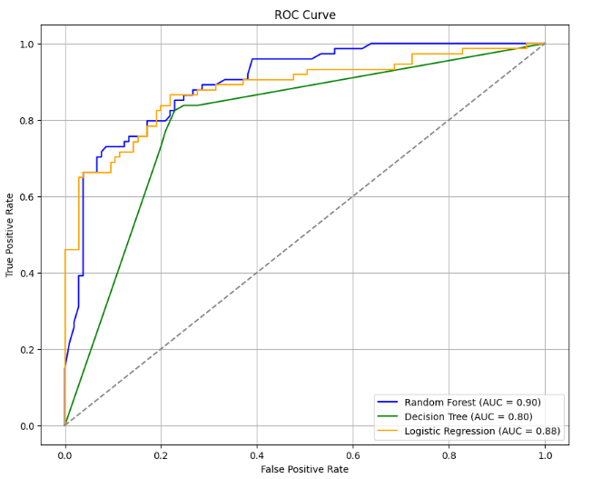

ROC Curve
Conclusion
The Random Forest model is recommended for this task due to its superior performance, particularly in identifying key features such as Sex, Fare, and Age, which have the highest importance scores.
The Random Forest model is the best choice among the three, as it has the highest AUC score (0.90), followed by Logistic Regression (0.88). The Decision Tree, with an AUC of 0.80, is the least effective.

Slide 18



Thank You!
www.linkedin.com/in/tari-aisyah-putri
@tariaisyahp

